Slide 1
Human-Human Interaction Experiment
Clustering
Zhanibek Rysbek

Slide 2
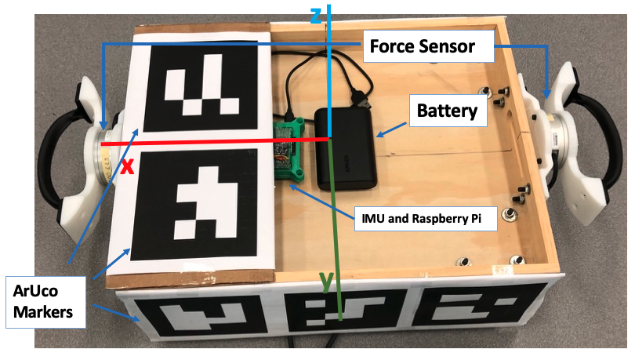
Sensor Data
Force-Torque Sensor
9 DOF IMU Sensor
Vision based Position Tracking
Three USB cameras to deal with occlusion

Slide 3
Motion Primitives
Parallel
Serial
Notes:
Multiple negotiation points.
Negotiation of the future trajectory happens at the beginning of the interaction. Once the choice has been made execution phase starts.
However, without giving instructions to the participants, we have observed two people were making another discrete choice whether to switch the sides or not. In

Slide 4
Summary and Future work
In a simple task humans engage in a number of discrete strategies
Higher level interaction manager that could mediate:
Physical Signals
Force
Twist
Gesture
Language
Notes:
In our preliminary study of a specific human-human interaction scenario, we have noticed that humans engage in a number of discrete strategies. This allows us to develop high level interaction manager that can connect symbolic meaning to these discrete behaviors.

Slide 5
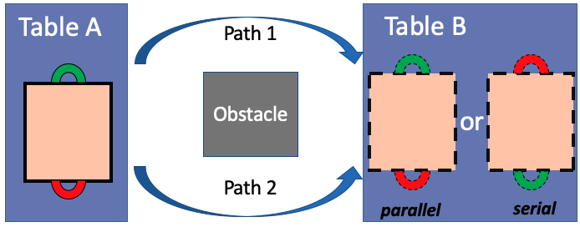
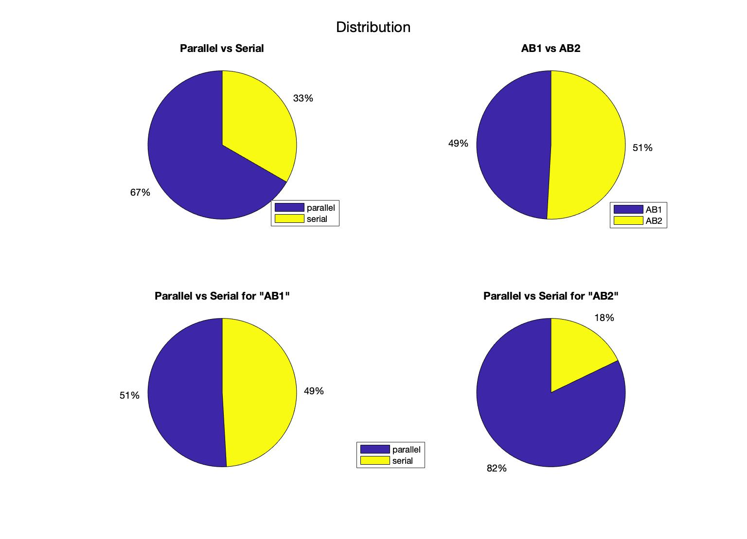
Data Description
Total number of Observations: 112
Average duration: 10 sec

Slide 6
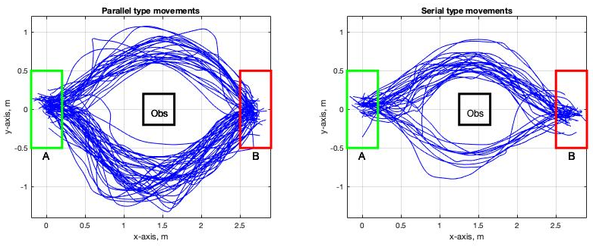
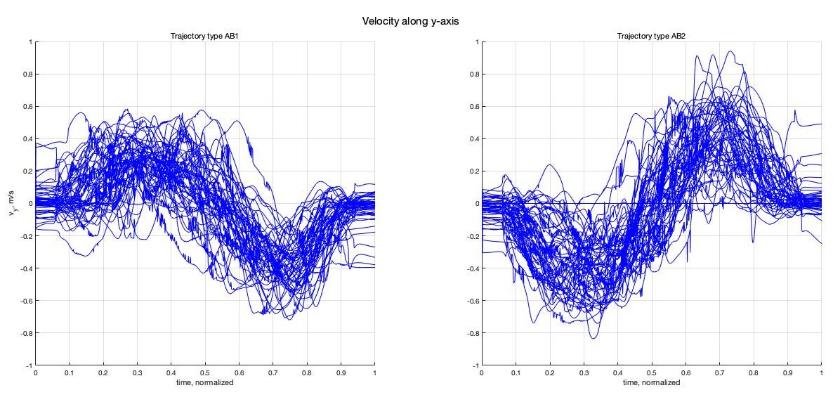
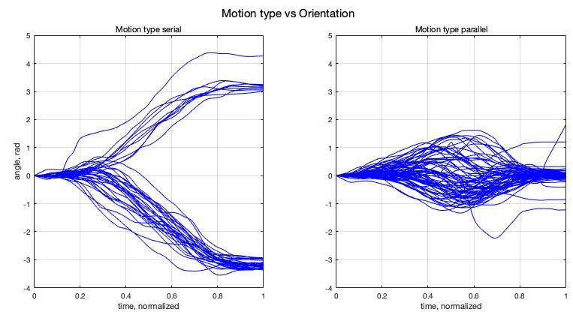

Slide 7
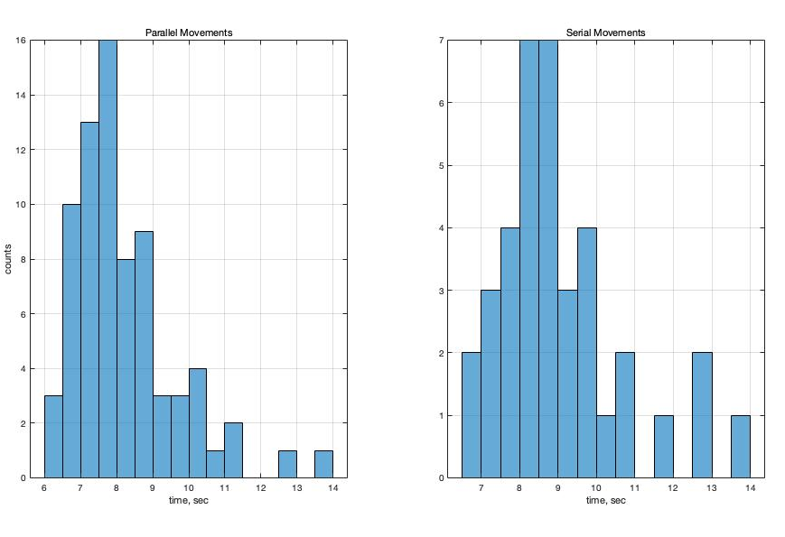
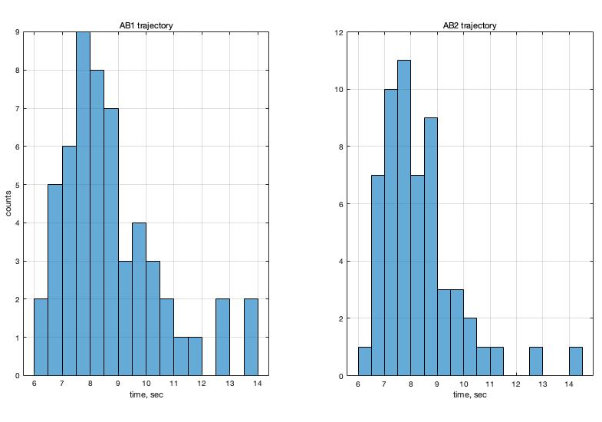
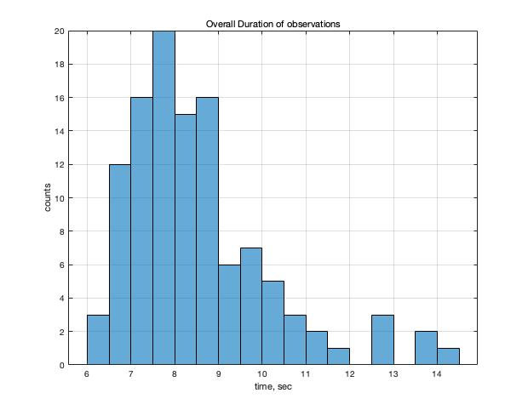
Duration Distributions

Slide 8
Sliding Window
Time is normalized between [0,1]
Window size: 0.5
Stride: 0.2
Divisions: 5
Features: [rft1(6) rft2(6) pose(7) twist(6) accel(3)]
Body Frame - except pose
Spatial Frame
Total Dimension: [5376, 140]

Slide 9
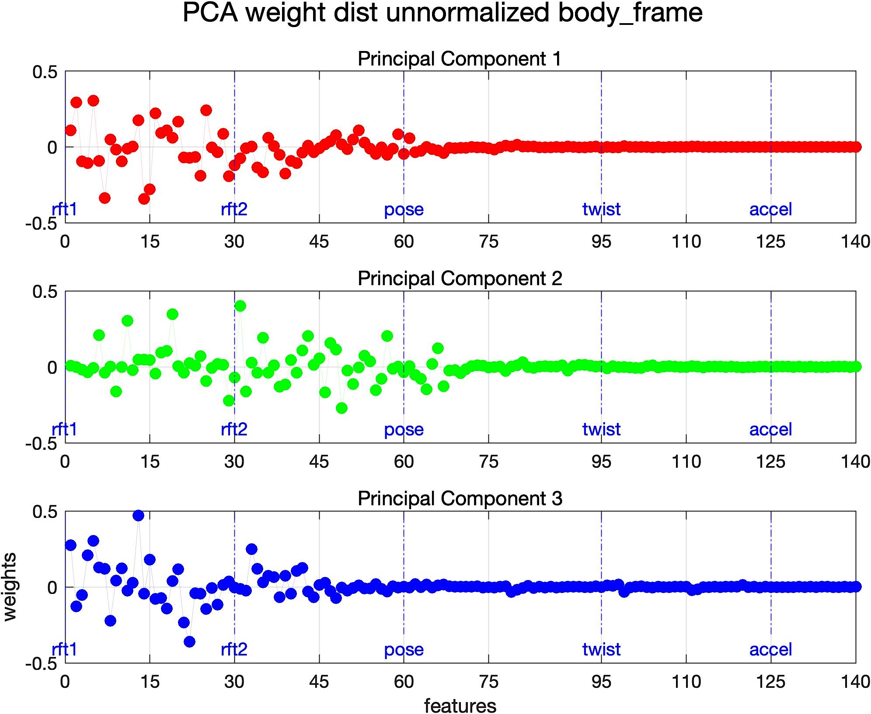
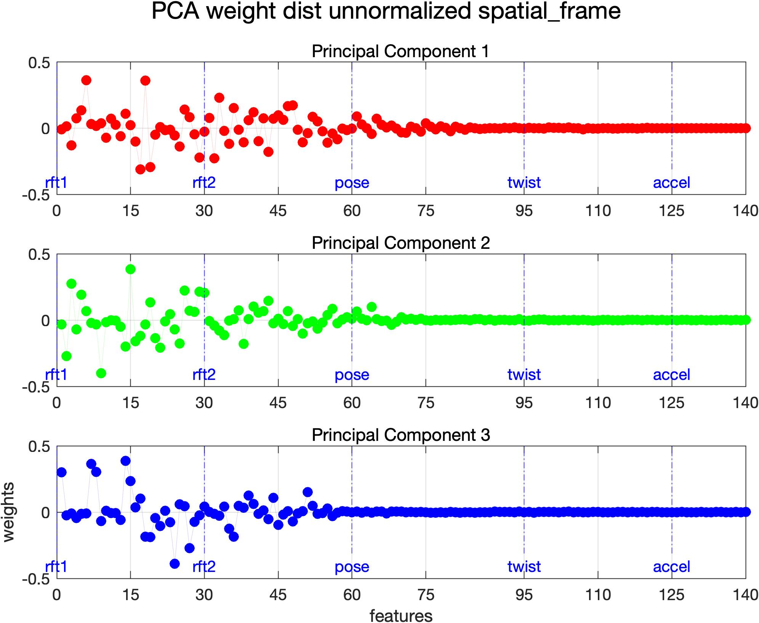
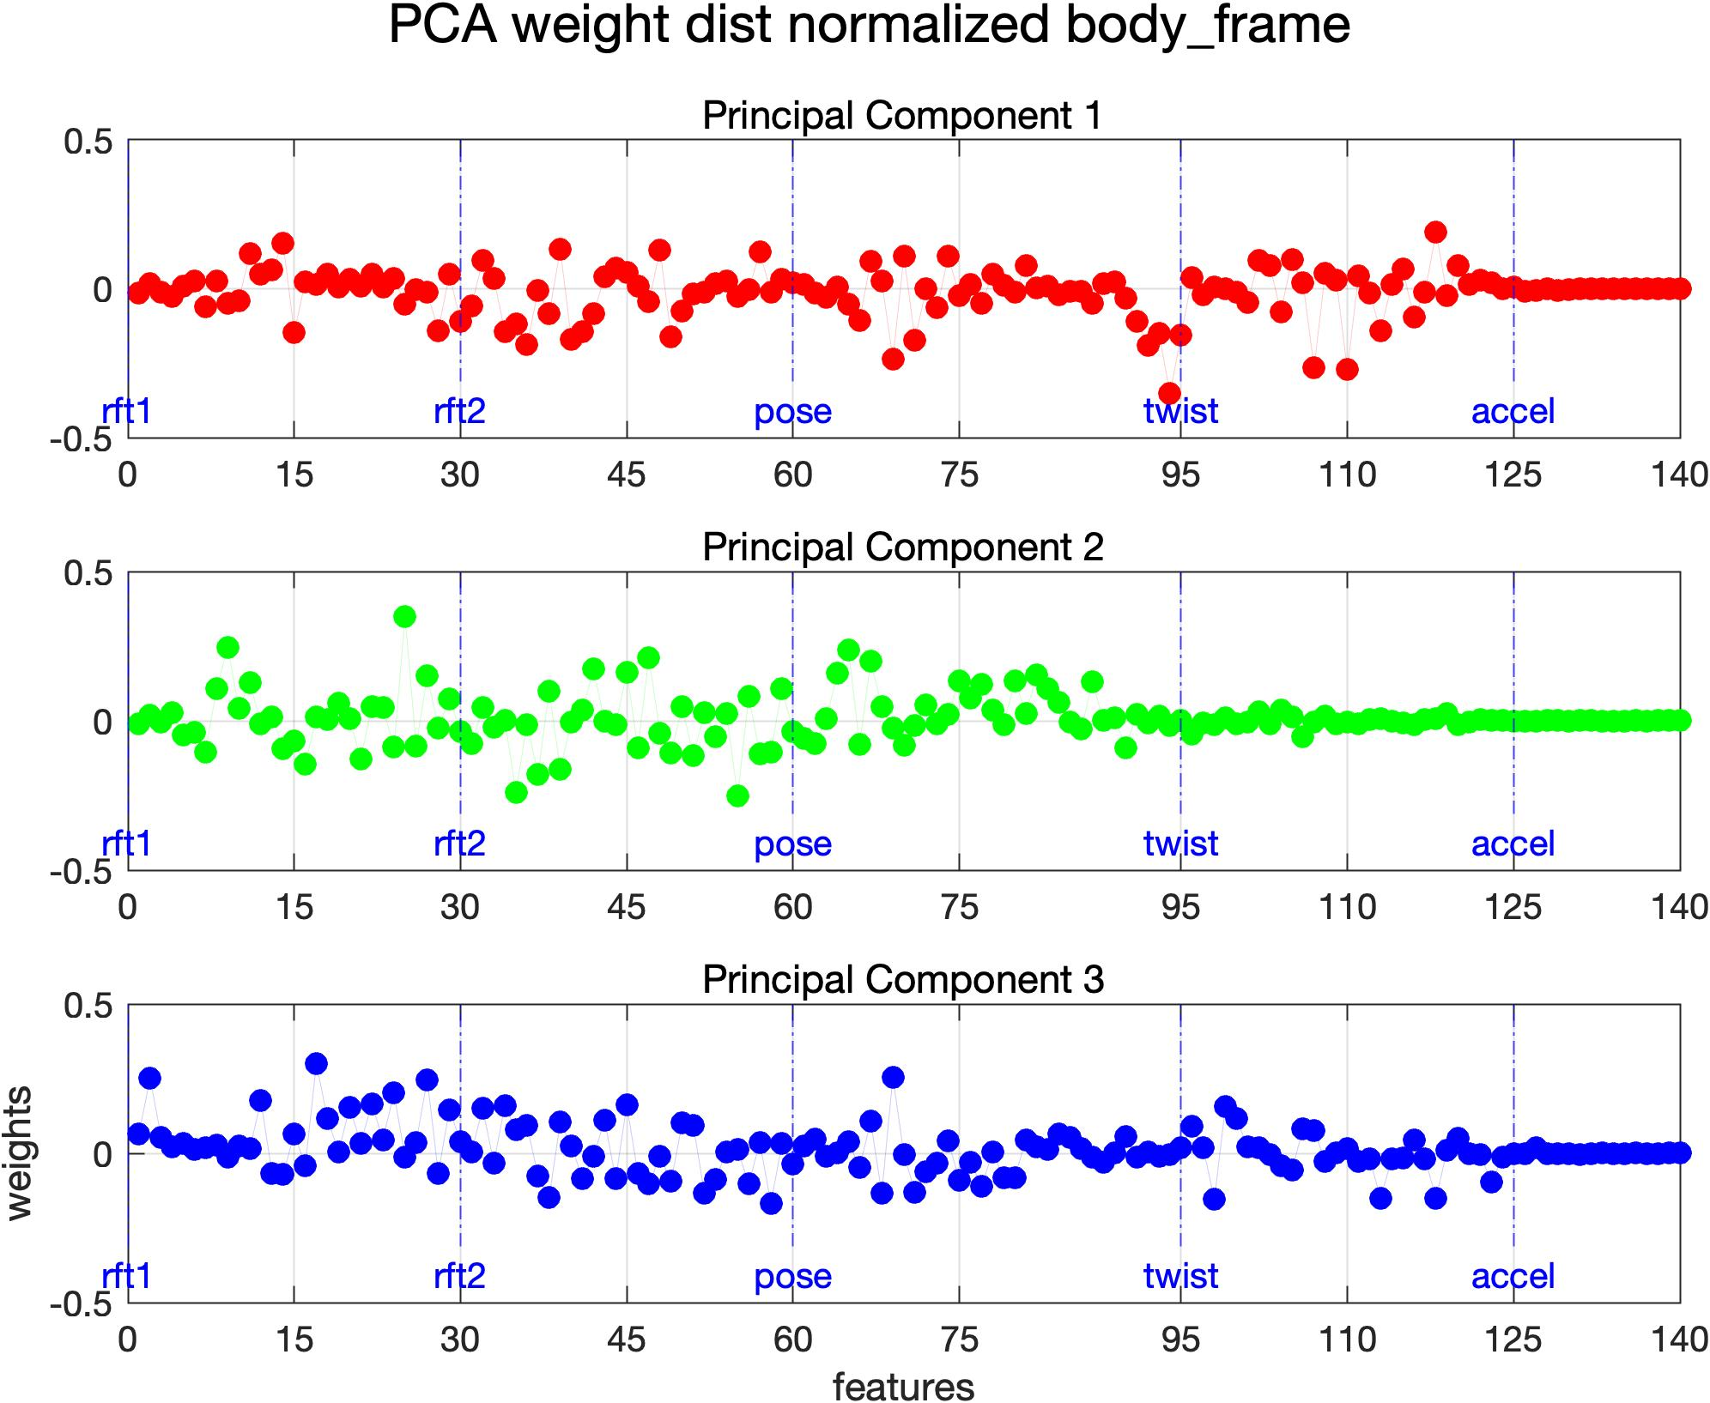
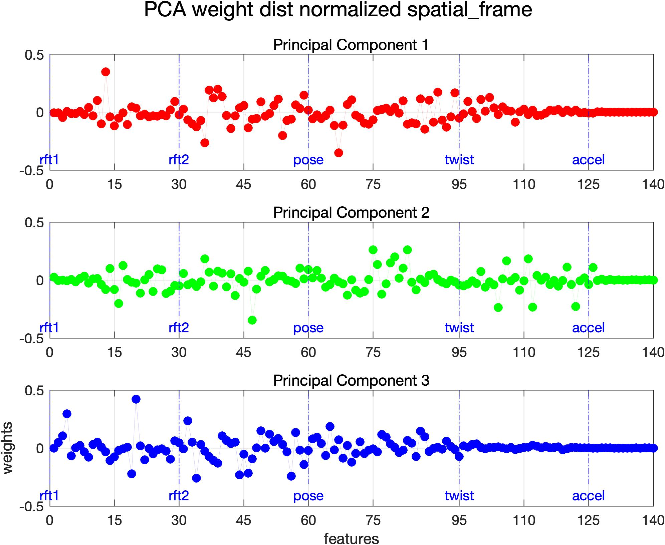
PCA - Weights
Body
Spatial

Slide 10
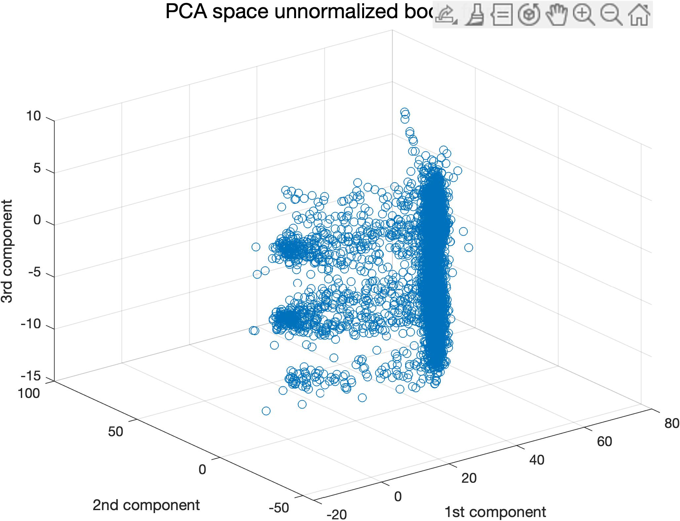
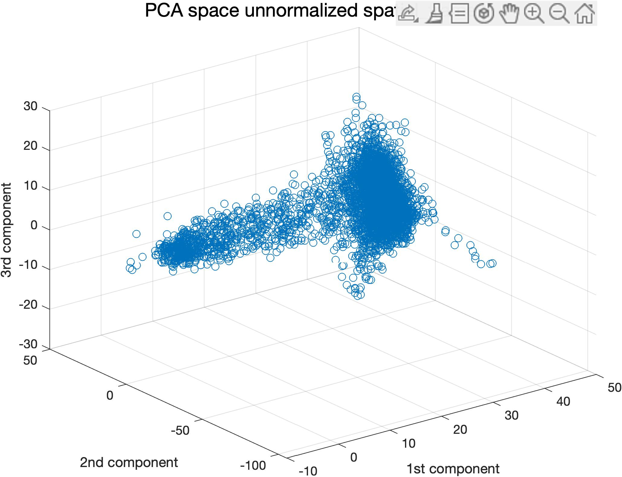

Slide 11
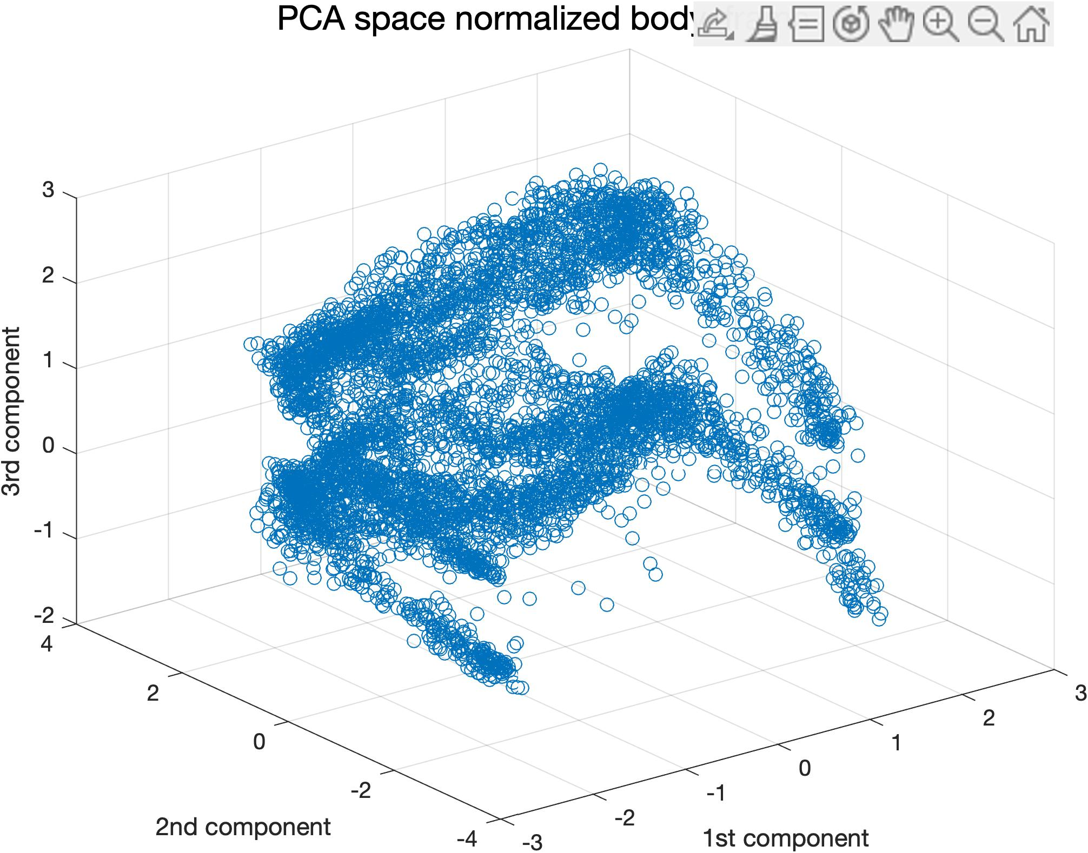
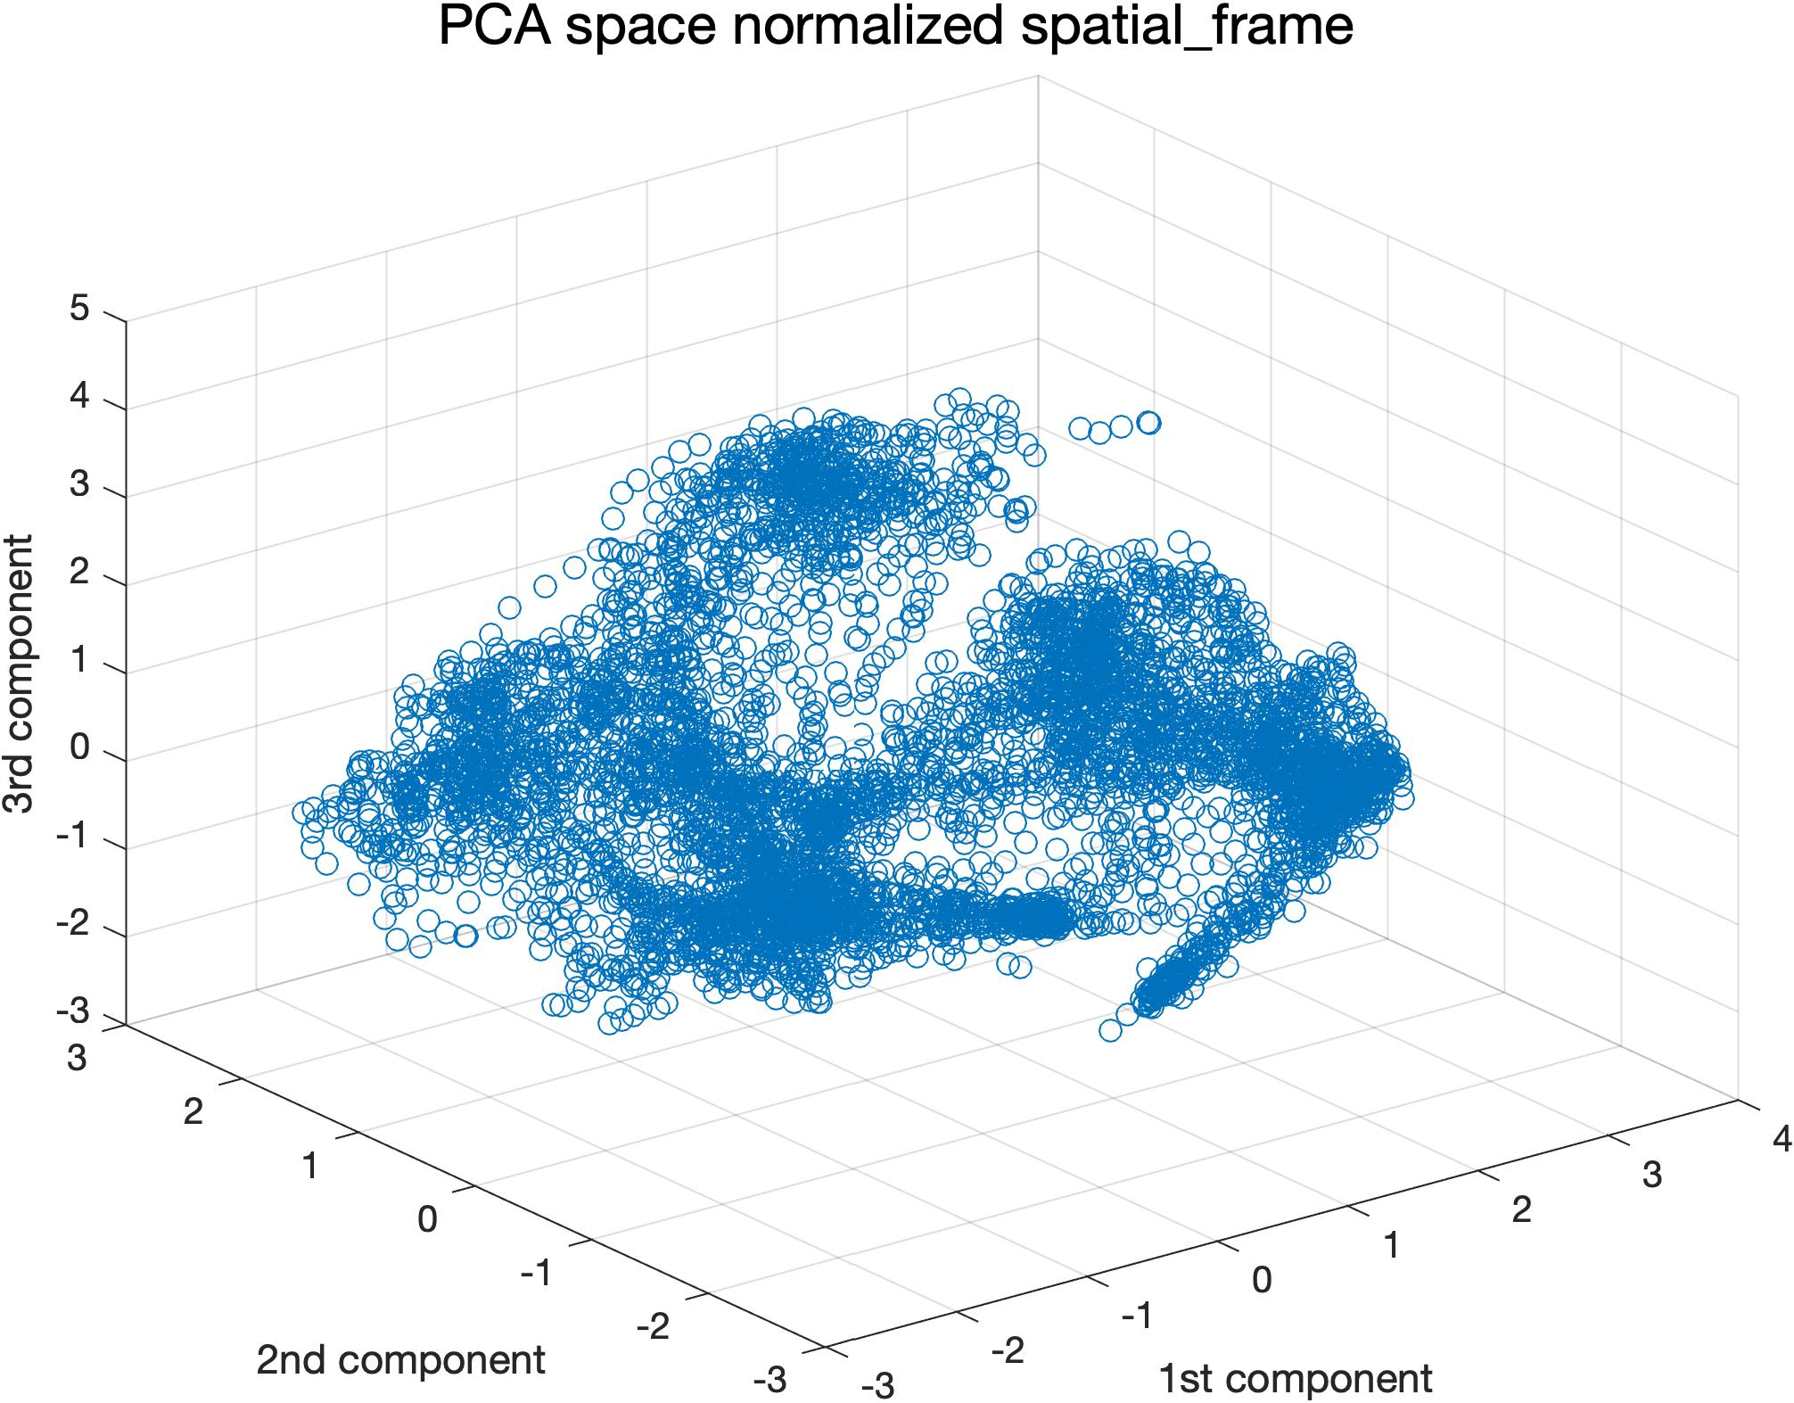

Slide 12
Kmeans

